Slide 1

Microsoft Power BI for Data Analytics
Amnuay M.

Slide 2



Agenda
About me
About you your goals
Introduction to Dashboard
Type of data

Slide 3



Amnuay M.
B. Acc, UTCC (2020) X-MBA, Rangsit U. (2010) B. Eng, Thammasat U (2000)
Head of Back-end Solutions Technology function FWD Insurance Plc.
23 yrs of experience from Technical engineer –> IT Practical strategic management
https://th.linkedin.com/in/amnuay

Slide 4



About you About goals,
Short term goals
Mid term goals
Long term goals
What to complete within 1-2 years
What to complete within 5-10 years
What to achieve in life

Slide 5
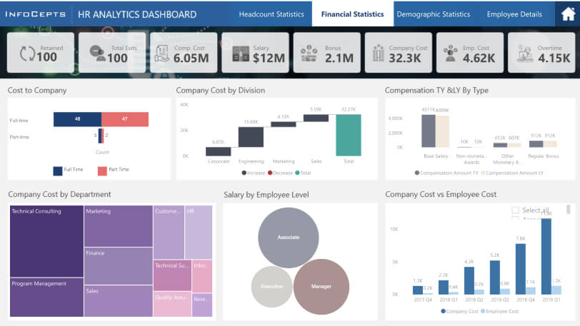
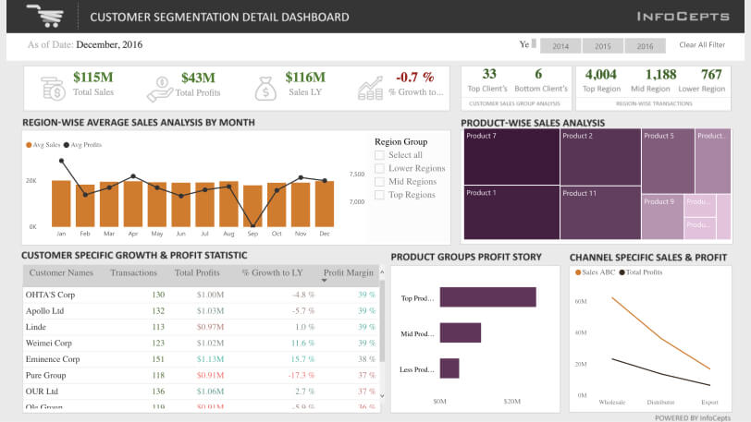
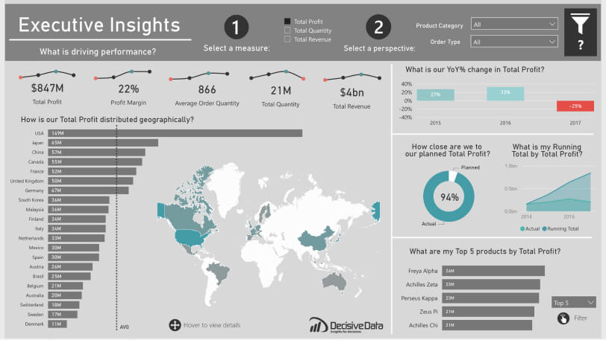
Introduction to Dashboard
Business dashboard / Management Dashboard is a type of graphical user interface which often provides at-a-glance views of key performance indicators (KPIs) relevant to a particular objective or business process. (Wikipedia)
Data dashboard (Power BI)
Employee dashboards
Customer support or IT tickets closed per hour
Billable project hours per teammate
Hours a team took to complete a given project
Sales dashboards
Sales funnel compared to previous year
Total sales pipeline dollars
Average time it takes to make a sale
Financial dashboards
Earnings before interest, tax, depreciation, or amortization
Operating cash flow
Net profit margin
More resources
Tableau

Slide 6
Type of data
ข้อมูลเชิงคุณภาพ
ข้อมูลเชิงปริมาณ
Qualitative
Quantitative
Nominal data
Ordinal data
Discrete data
Continuous data
ข้อมูลประเภทนามบัญญัติ
ข้อมูลประเภทมาตรบัญญัติ
ข้อมูลแบบไม่ต่อเนื่อง
ข้อมูลแบบต่อเนื่อง
สถิติ
- ความถี่
- อัตราส่วน ร้อยละ
สถิติ
- ความถี่
- อัตราส่วน ร้อยละ
- เปอร์เซ็นไทล์
Structure data
Unstructured data
Transactional data
Master data
Reference data
Meta data

Slide 7
Type of data
Structure data
Unstructured data
Reference data
Report data
Transactional data
Meta data
Master data
More resources
Semarchy.com
Unstructure data on Wikipedia
Bigdata on Wikipedia
More resources
Lawtomated.com

Slide 8
How to create a data dashboard
Define your audience and goals:
Ask who you are building this dashboard for and what do they need to understand? Once you know that, you can answer their questions more easily with selected visualizations and data.
Choose your data:
Most businesses have an abundance of data from different sources. Choose only what’s relevant to your audience and goal to avoid overwhelming your audience with information.
Double-check your data:
Always make sure your data is clean and correct before building a dashboard. The last thing you want is to realize in several months that your data was wrong the entire time.
Choose your visualizations:
There are many different types of visualizations to use, such as charts, graphs, maps, etc. Choose the best one to represent your data. For example, bar and pie charts can quickly become overwhelming when they include too much information.
Use a template:
When building a dashboard for the first time, use a template or intuitive software to save time and headaches. Carefully choose the best one for your project and don’t try to shoehorn data into a template that doesn’t work.
Keep it simple:
Use similar colors and styles so your dashboard doesn’t become cluttered and overwhelming.
Iterate and improve:
Once your dashboard is in a good place, ask for feedback from a specific person in your core audience. Find out if it makes sense to them and answers their questions. Take that feedback to heart and make improvements for better adoption and understanding.

Slide 9
Dashboard sample
COVID-19 Data Stories Gallery - Microsoft Power BI Community
#COVID-19 Dashboard - From Data to Insights - Microsoft Power BI Community

Slide 10
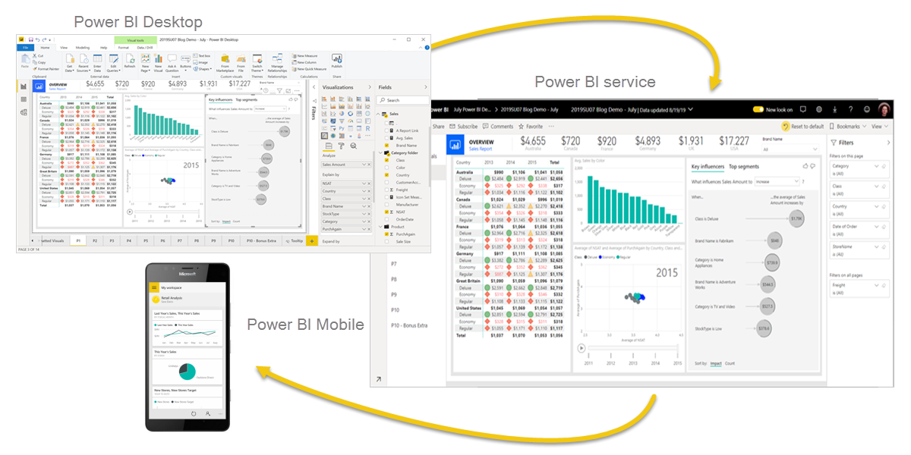
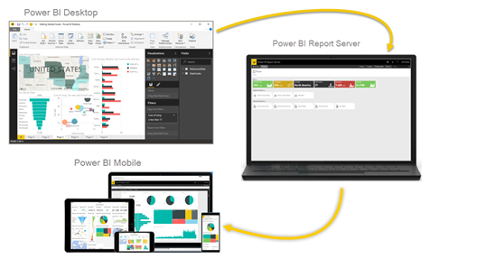
Power BI Components
On-premise
On-cloud
Resources Learn Microsoft

Slide 11
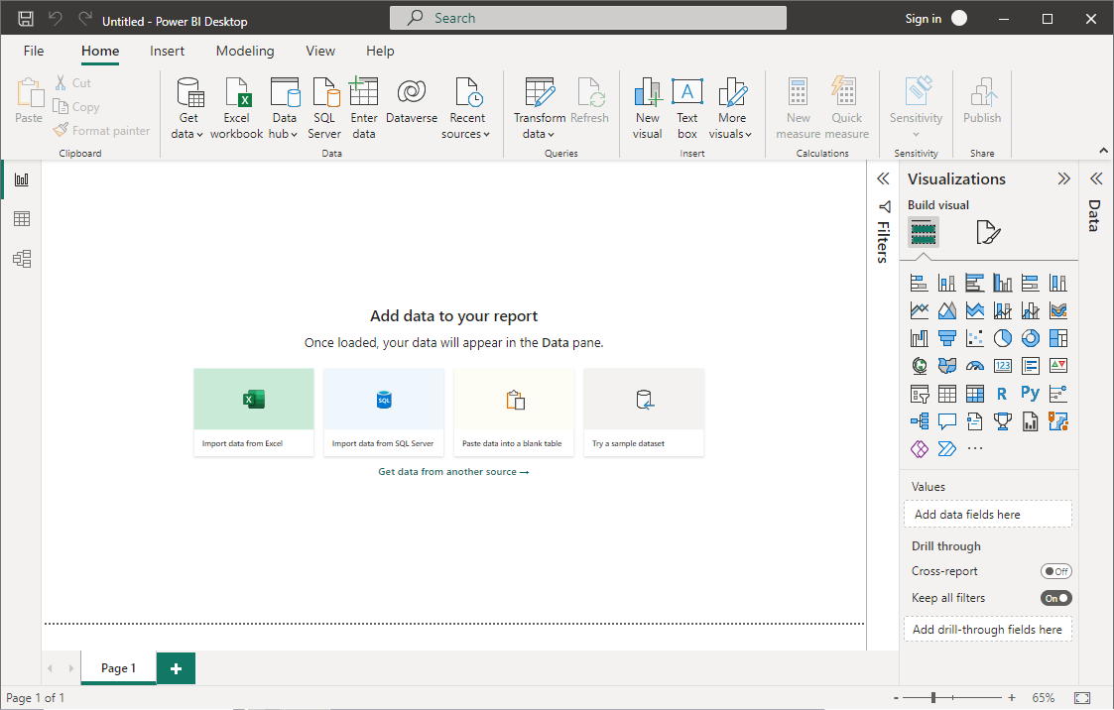
Dashboard sample

Slide 12
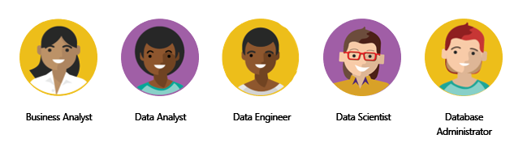
Data analytics
While the process of data analysis focuses on the tasks of cleaning, modeling, and visualizing data, the concept of data analysis and its importance to business should not be understated. To analyze data, core components of analytics are divided into the following categories:
Descriptive analytics – Describe and summary data suite for KPI, reports, summary
Diagnostic analytics – Identify anomalies in the data, Collect data that’s related to these anomalies and explain trends
Predictive analytics – Predict future from historical data to determine the likelyhood.
Prescriptive analytics – Help answer questions about which actions should be taken to achieve a goal or target
Cognitive analytics – Attempt to draw inferences from existing data and pattern. Predict future inference with self-learning feedback

Slide 13
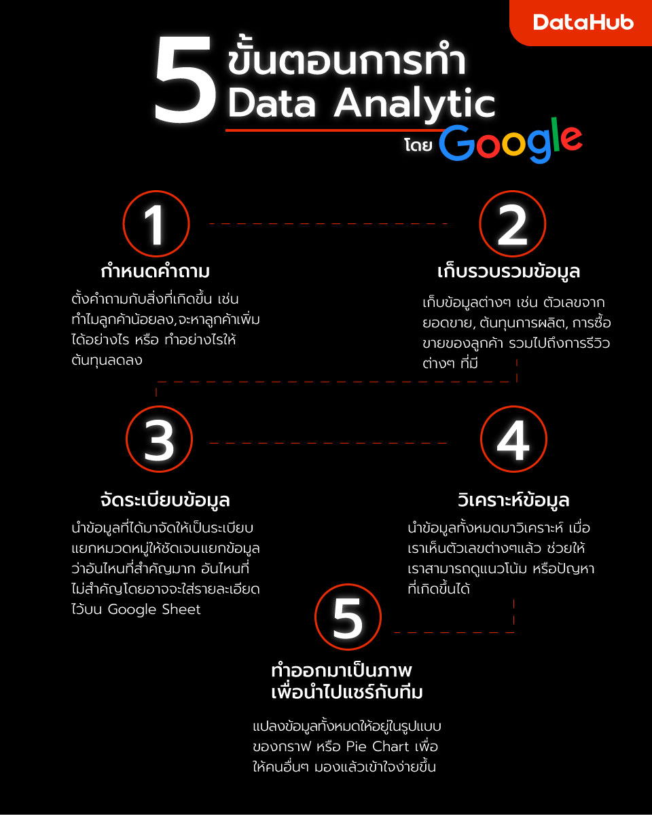

Slide 14
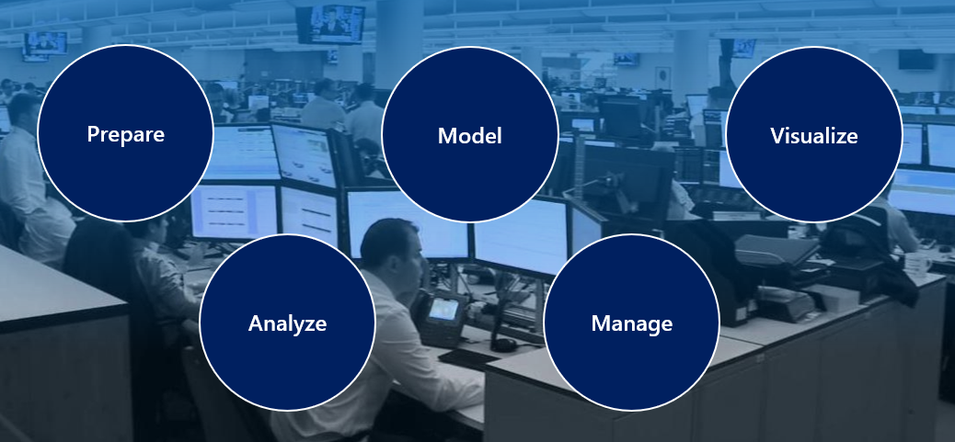
Tasks of Data analyst
Notes:
Prepare
Data preparation also involves understanding how you're going to get and connect to the data and the performance implications of the decisions. When connecting to data, you need to make decisions to ensure that models and reports meet, and perform to, acknowledged requirements and expectations.
Model
Creating an effective and proper data model is a critical step in helping organizations understand and gain valuable insights into the data. An effective data model makes reports more accurate, allows the data to be explored faster and more efficient, decreases time for the report writing process, and simplifies future report maintenance.
Visualize
The visualization task is where you get to bring your data to life. The ultimate goal of the visualize task is to solve business problems. A well-designed report should tell a compelling story about that data, which will enable business decision makers to quickly gain needed insights. By using appropriate visualizations and interactions, you can provide an effective report that guides the reader through the content quickly and efficiently, therefore allowing the reader to follow a narrative into the data.
Analyze
The analyze task is the important step of understanding and interpreting the information that is displayed on the report. In your role as a data analyst, you should understand the analytical capabilities of Power BI and use those capabilities to find insights, identify patterns and trends, predict outcomes, and then communicate those insights in a way that everyone can understand.
Manage
Proper management can also help reduce data silos within your organization. Data duplication can make managing and introducing data latency difficult when resources are overused. Power BI helps reduce data silos with the use of shared datasets, and it allows you to reuse data that you have prepared and modeled. For key business data, endorsing a dataset as certified can help to ensure trust in that data.

Slide 15
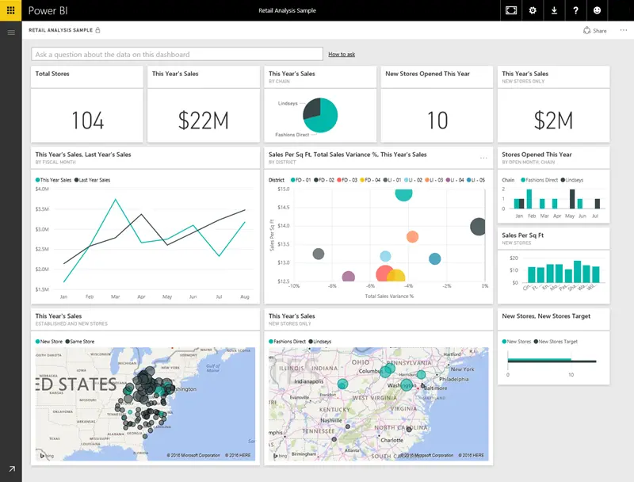
Visualizations
Notes:
A visualization (sometimes also referred to as a visual) is a visual representation of data, like a chart, a color-coded map, or other interesting things you can create to represent your data visually. Power BI has all sorts of visualization types, and more are coming all the time. The following image shows a collection of different visualizations that were created in Power BI.

Slide 16
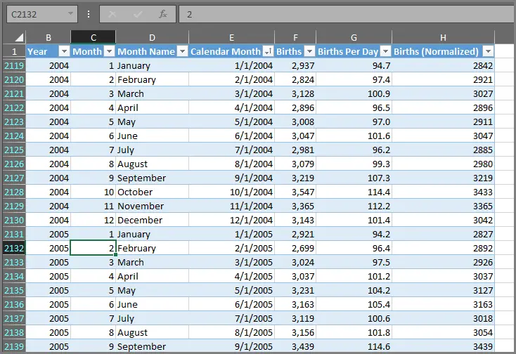
Datasets

Slide 17
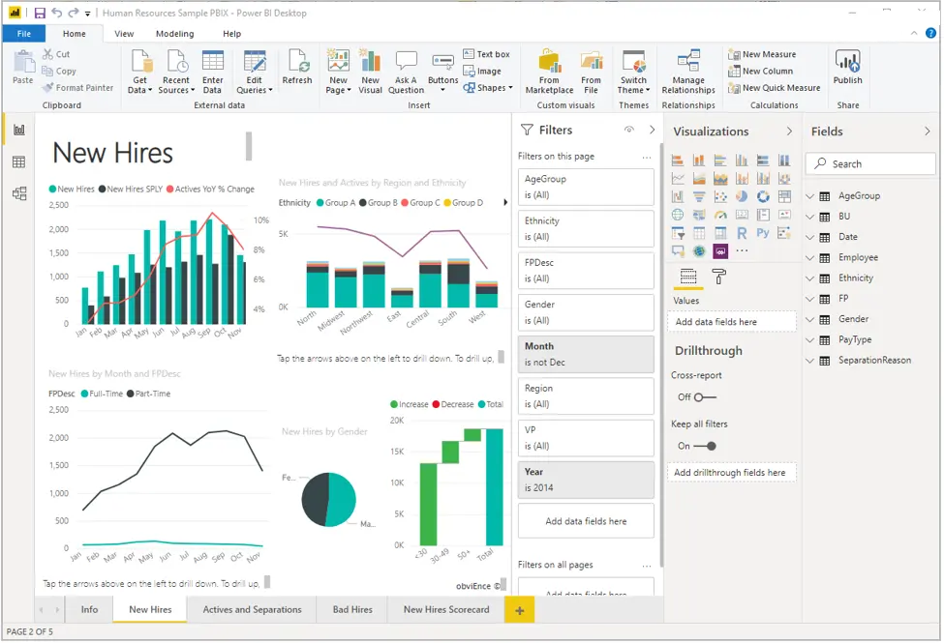
Reports & Dashboard

Slide 18
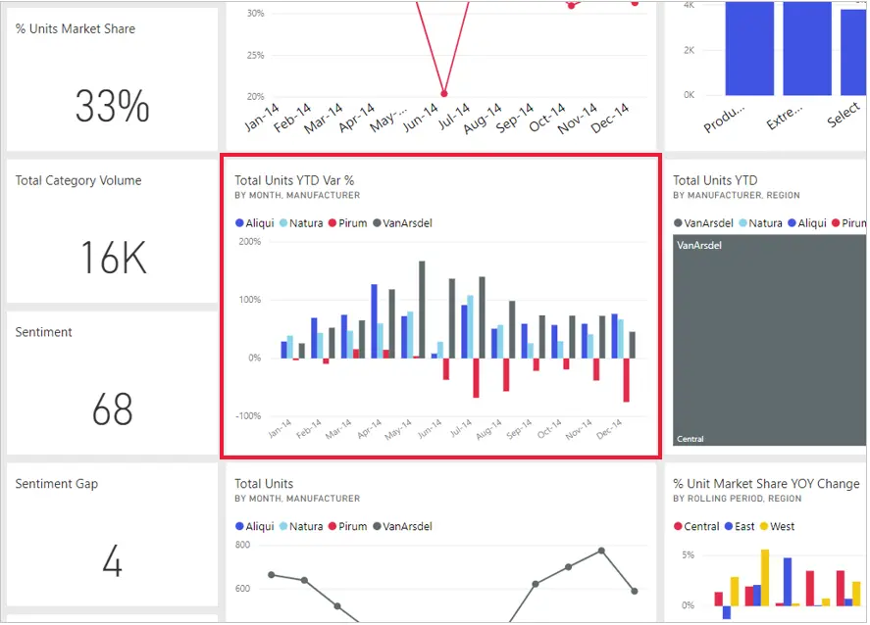
Tiles

Slide 19
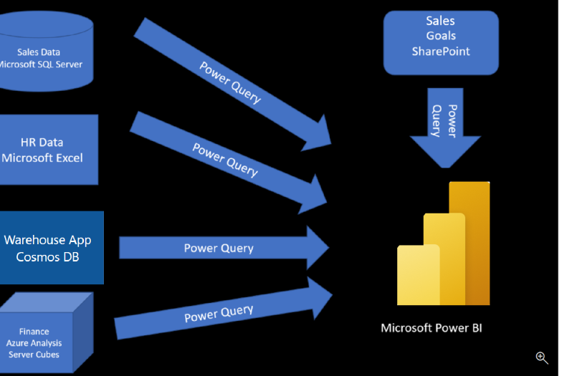
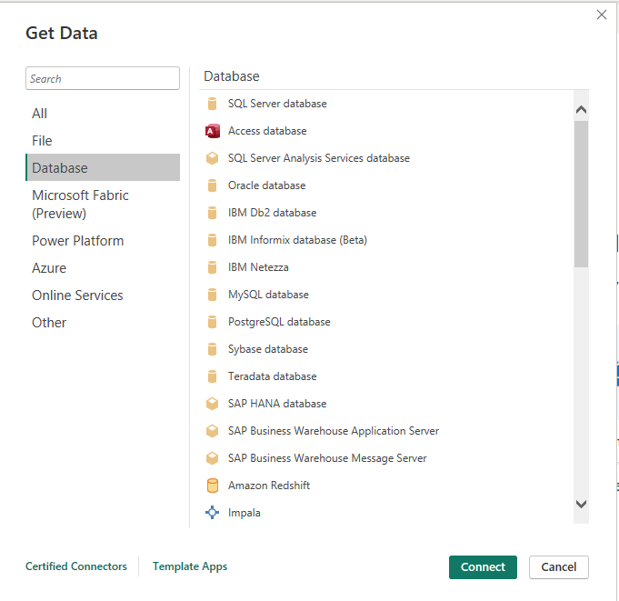
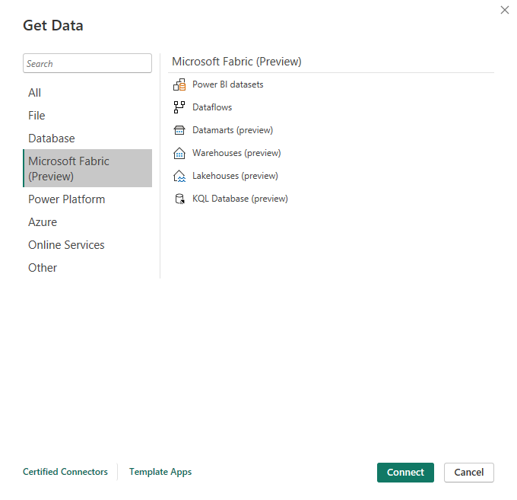
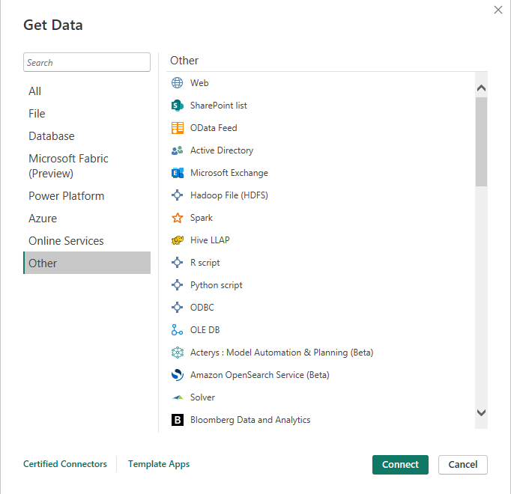
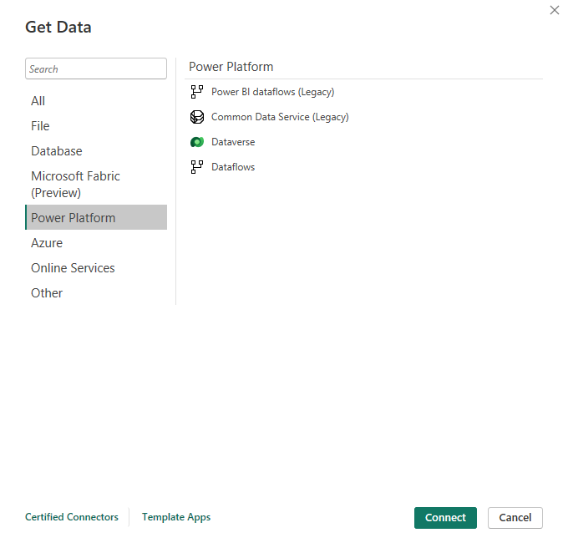
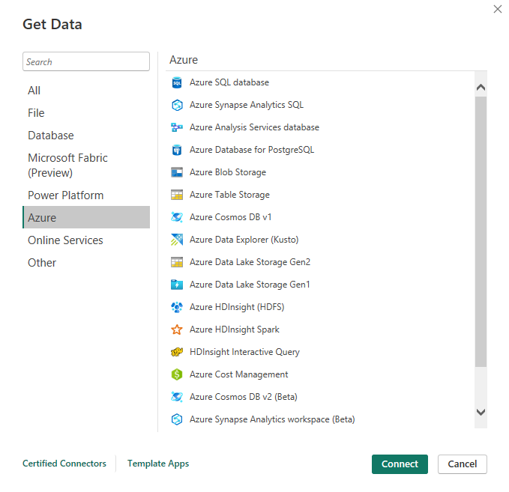
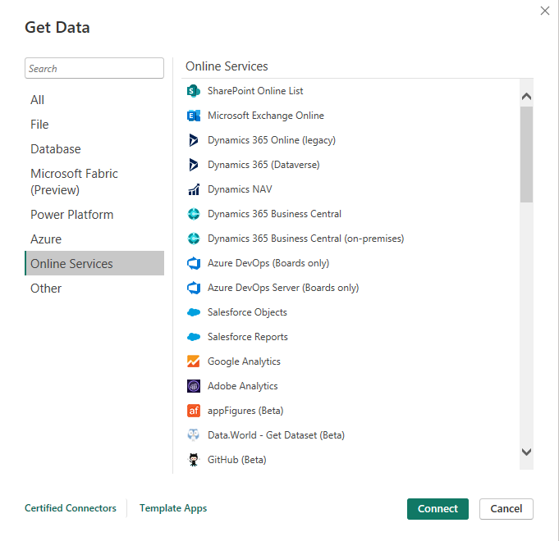
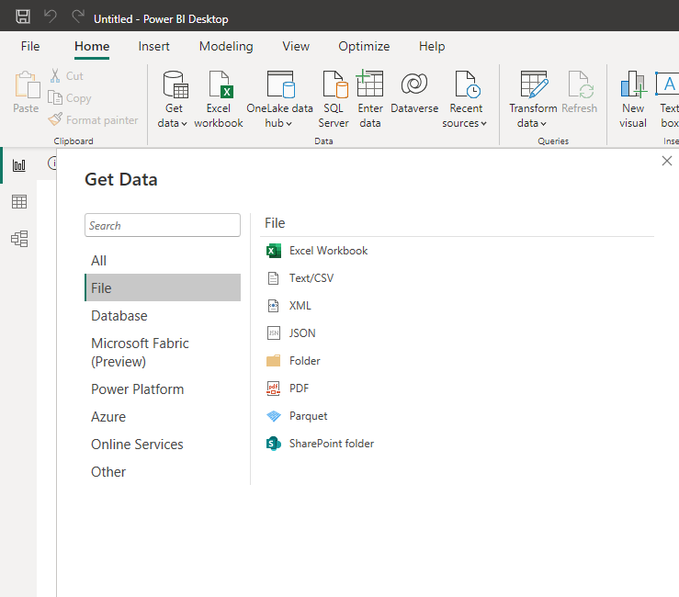
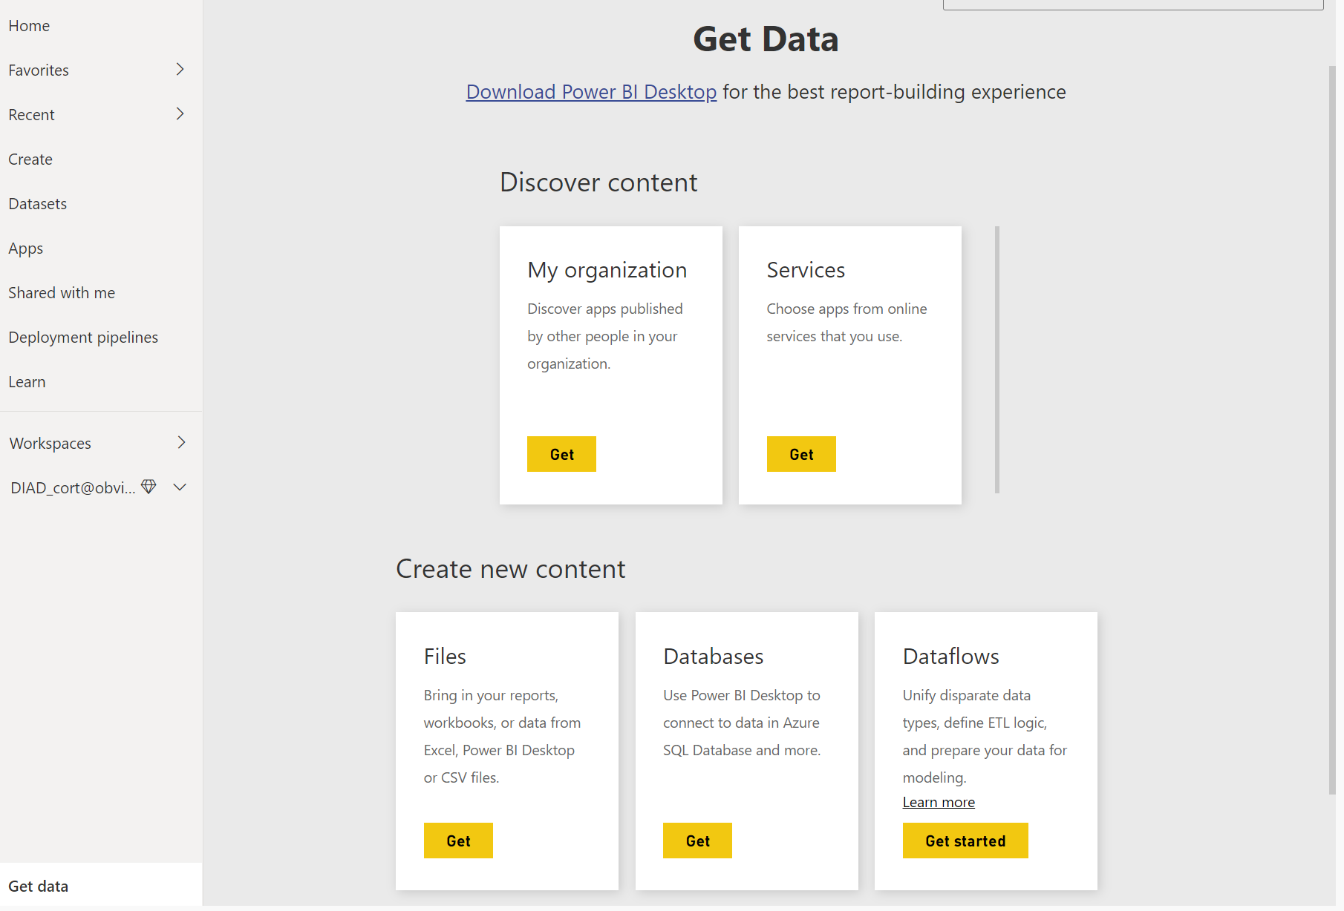
Get Data

Slide 20
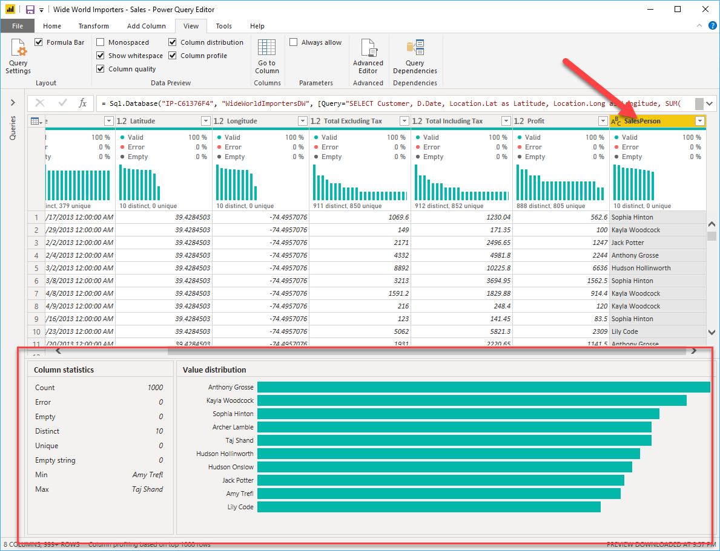
Data preparation
Merge data
Data quality
Data cleansing

Slide 21
Syllabus
I. Introduction to Power BI (15 minutes)
What is Power BI and what can it do?
Understanding the Power BI Desktop interface
II. Getting Started (30 minutes)
Installing Power BI Desktop
Connecting to data sources
Importing data into Power BI Desktop
III. Data Transformation (45 minutes)
Cleaning and shaping data
Creating calculated columns and measures
Filtering and sorting data
Creating relationships between tables
IV. Data Visualization (60 minutes)
Choosing the right visualizations
Creating visualizations using charts, tables, and maps
Adding drill-down and drill-through capabilities
Customizing visualizations with formatting options
V. Advanced Topics (45 minutes)
Creating hierarchies and groups
Using DAX formulas
Creating KPIs and scorecards
Sharing and collaborating on reports
VI. Conclusion (15 minutes)
Recap of what was covered
Next steps for learning Power BI

Slide 22
Q&A

Slide 23
Last but not least
Where to find all resources
Keep on working
https://learn.microsoft.com/en-us/certifications/power-bi-data-analyst-associate/
https://learn.microsoft.com/en-us/training/browse/?filter-products=power%20BI&products=power-bi

Slide 24

Thank you.
Amnuay M.
LINE ipad.amnuay
More resources:

Slide 26
Chart

Slide 27
Table
 | Category 1 | Category 2 | Category 3 | Category 4
Item 1 | 4.5 | 2.3 | 1.7 | 5
Item 2 | 3.2 | 5.1 | 4.4 | 3
Item 3 | 2.1 | 1.7 | 2.5 | 2.8
Item 4 | 4.5 | 2.2 | 1.7 | 7

Slide 28

The way to get started is to quit talking and begin doing.
Walt Disney

Slide 29




Team
Name
Name
Name
Name
Title
Title
Title
Title

Slide 30
Timeline
Title
To start a presentation, go to the Slide Show tab, and select From Beginning.
Title
To display Presenter view, in Slide Show view, on the control bar at the bottom left select the three dots, and then Show Presenter View.
Title
During your presentation, the speaker notes are visible on your monitor, but aren't visible to the audience.
Title
Title
If you don’t see the Notes pane or it is completely minimized, click Notes on the task bar across the bottom of the PowerPoint window.
The Notes pane is a box that appears below each slide. Tap it to add notes.

Slide 31
Content
Subtitle
Subtitle
Add text, images, art, and videos.
Add transitions, animations, and motion.
Save to OneDrive, to get to your presentations from your computer, tablet, or phone.
Open the Design Ideas pane for instant slide makeovers.
When we have design ideas, we’ll show them to you right there.

Slide 32
Content 2
Subtitle
subtitle
subtitle
Add text, images, art, and videos.
Add transitions, animations, and motion.
Save to OneDrive, to get to your presentations from your computer, tablet, or phone.
Open the Design Ideas pane for instant slide makeovers.
When we have design ideas, we’ll show them to you right there.
Add text, images, art, and videos.
Add transitions, animations, and motion.
Save to OneDrive, to get to your presentations from your computer, tablet, or phone.
Open the Design Ideas pane for instant slide makeovers.
When we have design ideas, we’ll show them to you right there.
Add text, images, art, and videos.
Add transitions, animations, and motion.
Save to OneDrive, to get to your presentations from your computer, tablet, or phone.
Open the Design Ideas pane for instant slide makeovers.
When we have design ideas, we’ll show them to you right there.

Slide 33

Summary
With PowerPoint, you can create presentations and share your work with others, wherever they are. Type the text you want here to get started. You can also add images, art, and videos on this template. Save to OneDrive and access your presentations from your computer, tablet, or phone.

Slide 34


Thank You
Presenter name
Email address
Website address

